Slide 1
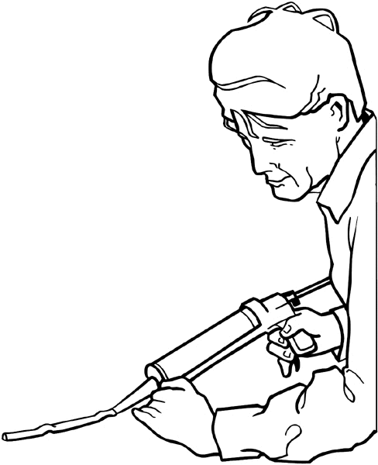
Safety rules in the workshop.
1. You are responsible for your own safety and the safety of others.
2. N0 alcohol or drugs to be used in the workshop.
3. Wear appropriately and safe clothing and footwear.
4. Always use equipments /tools /machinery safely and properly.
5. Wear personal protective equipments necessary for the job.
6. Keep your work area clean.
7. Clean up the spills immediately.
8. Lift properly using your legs not your back.
9. Report any unsafe condition.
10. Report all injuries.
Video :
_
Feedback : Activity

Slide 2
Kwa Thema Skills School
Subject : Maintenance Marks : 10
Grade : Year 2 Time : 30mins
Date :
SAFETY RULES No alcohol or ___________to be used or allowed in the Workshop. You are responsible for your own safety and _____________ of others. Clean up the _______________ immediately. ______________ all injuries. Keep your work area ___________. Wear appropriate and safe _____________ and footwear. __________ properly using your legs not your back. Always use equipments/ tools/ _________________ safely and properly. Wear personal _________________ equipments necessary for the job. Report any unsafe ____________________. (10)

